Slide 1
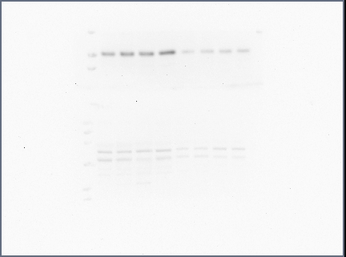
Introduction to Western Blotting

Slide 2
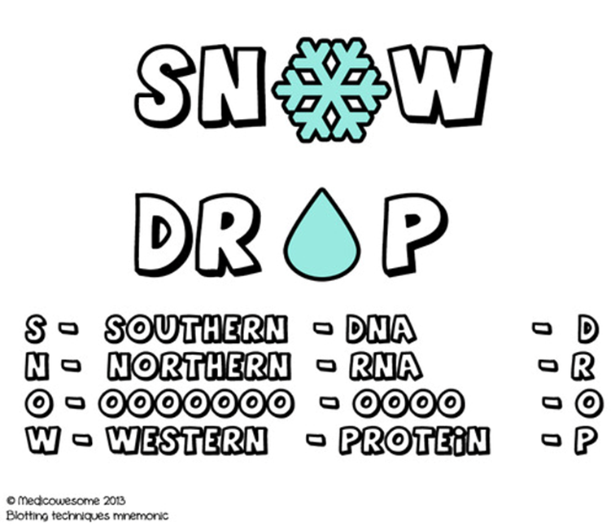
What is Western blotting?
Blotting = transfer of biological samples from a gel to a membrane
Uses an antibody to detect a particular protein in a complex mixture
Qualitative & semi-quantitative

Slide 3
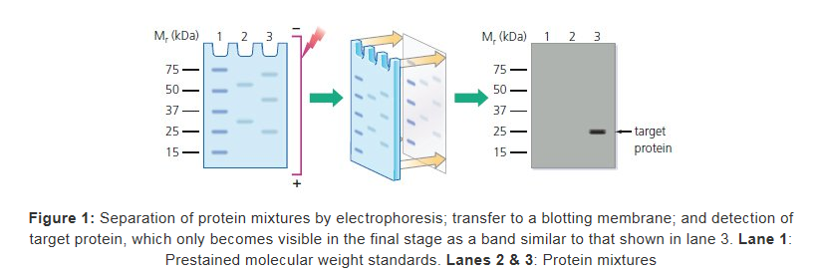

Slide 4
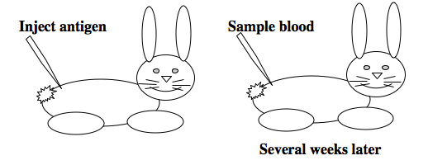
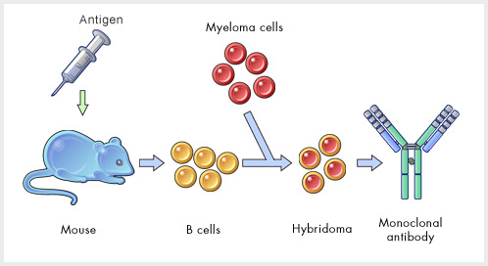
Antibodies
Charateristic of vertebrate immune systems
Insects do not produce antibodies themselves!
Polyclonal (mixed ) antibodies
Monoclonal (pure) antibodies

Slide 5
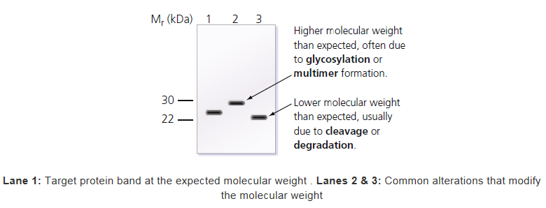
Why not just use ELISA?
Size helps confirm identity of target protein (specificity of binding)
When data is unexpected, Westerns provide clues for underlying reasons:
Westerns used to confirm results of ELISAs and/or immunohistochemistry

Slide 6
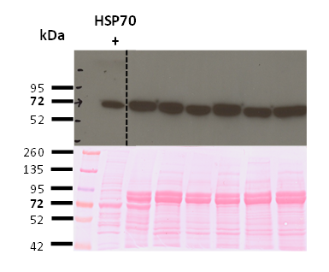
ELISA vs. Western???
Boardman et al. 2013 J Insect Physiology
Clusella-Trullas et al. 2014 Antarctic Science

Slide 7
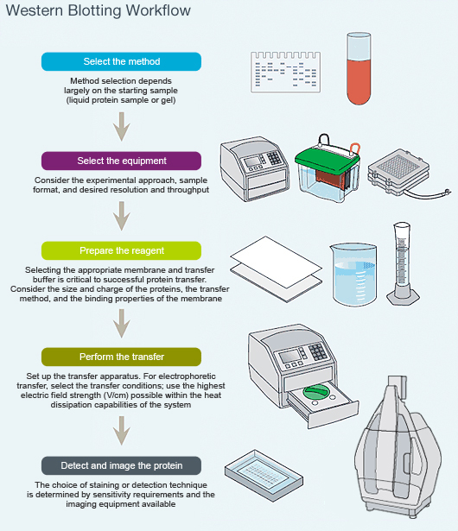
Main steps
Sample preparation
Extraction
Quantification
Denaturation
SDS-PAGE
Western transfer
Antigen detection (indirect method)
Blocking
Primary Ab
Secondary Ab
ECL

Slide 8
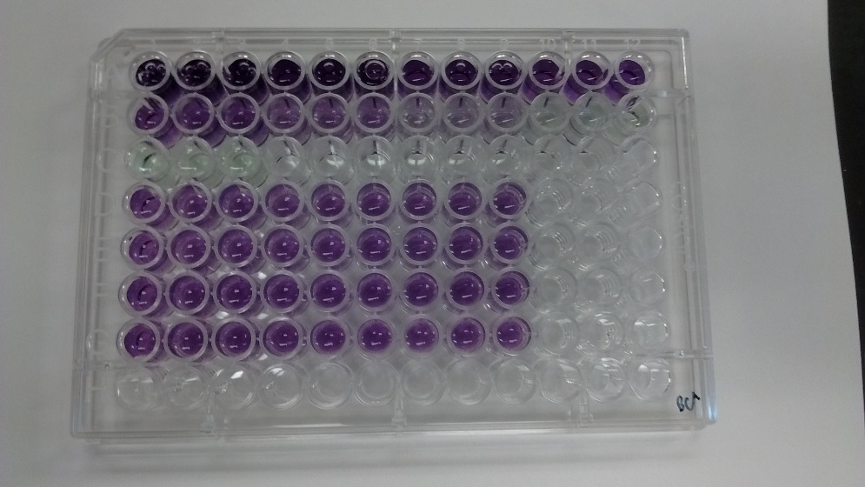
1. Sample preparation
Total proteins are extracted from tissue and quantified
___ µl protein to load 40µg onto gel
Samples denatured & “coated” with –ve charge

Slide 9
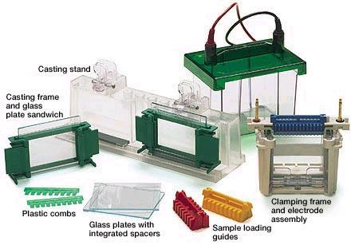
2. SDS-PAGE
Separate proteins based on size

Slide 10
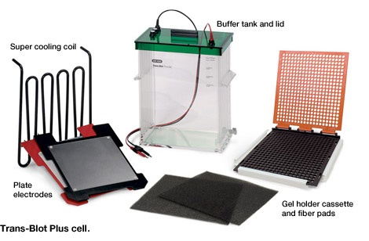
3. Western transfer
Transfer proteins from gel onto membrane

Slide 11
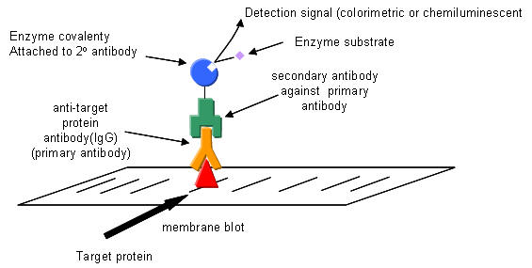
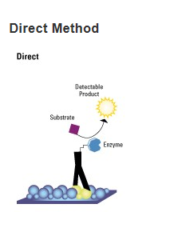
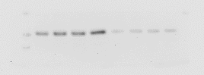
4. Antigen detection

Slide 12
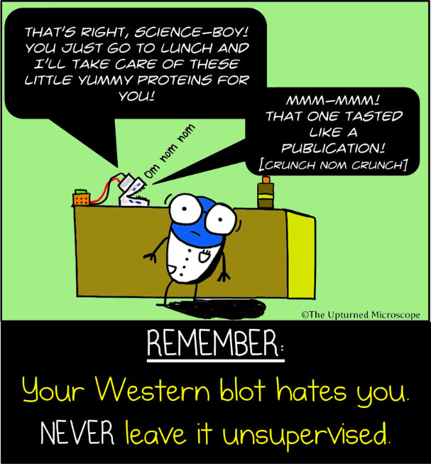
Things to remember when setting up a Western for the first time…
Loading controls
Protein ladder
Positive control*
Selection of
Extraction protocol
Gel type
Buffers
Membrane
Antibodies
*semi-quantitative

Slide 13
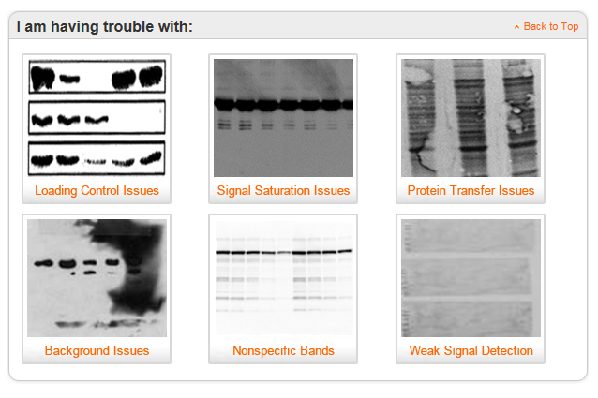
Online tools
BioRad Western Blot DoctorTM

Slide 14
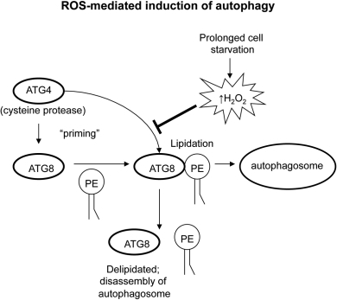
Our Western Blot…
Autophagy-related protein 8 (ATG8)
Barth et al 2011 Cell Death & Differentiation

